Slide 1
Cs1231S tutorial #10
Counting 2

Slide 2
Learning objectives of this tutorial
Counting
Counting combinations (where order does not matter).
Solving multiset problems.
Applying combinatorial argument in proof.
Applying Binomial Theorem.
Calculating expected value.
Using conditional probability and Bayes’ Theorem.

Slide 3


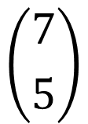

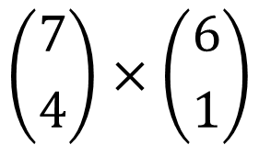




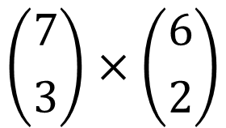



Q1.
Select 5 persons from 7 men and 6 women to form a committee with at least 3 men.
(a) In how many ways can you form the committee?
3 men, 2 women;
4 men, 1 woman;
5 men.
$$\left({7 \atop 3}\right)×\left({6 \atop 2}\right)$$
$$\left({7 \atop 4}\right)×\left({6 \atop 1}\right)$$
$$\left({7 \atop 5}\right)$$
$$+$$
$$+$$
$$35×15$$
$$+$$
$$35×6$$
$$+$$
$$21$$
$$=756$$

Slide 4
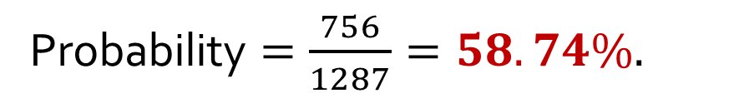

Q1.
Select 5 persons from 7 men and 6 women to form a committee with at least 3 men.
(b) If you randomly choose five persons to form the committee, what is the probability that you will get a committee with at least three men? Give your answer correct to 4 significant figures.
Number of outcomes in sample space: $\left({13 \atop 5}\right)=1287.$
From part (a), #ways to form a committee with at least 3 men $=756.$
Probability $=\frac{756}{1287}=58.74\%.$
To tutors: Students are to know what “4 significant figures” means. (Required for the exam!)

Slide 5

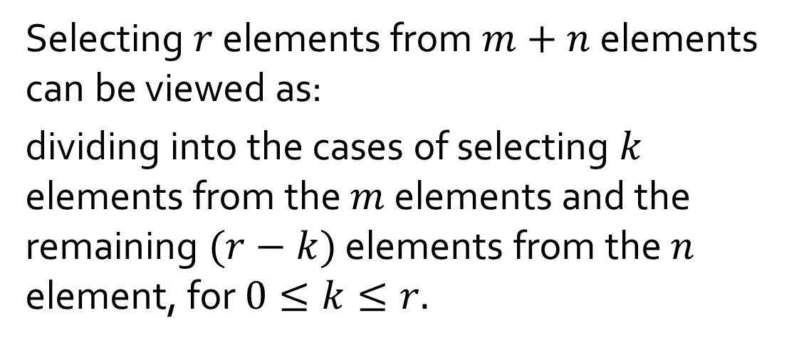






Q2.
Think of a set with $m+n$ elements as composed of 2 parts, one with $m$ elements and the other with $n$ elements. Give a combinatorial argument to show that:
$$\left({m+n \atop r}\right)=\left({m \atop 0}\right)\left({n \atop r}\right)+\left({m \atop 1}\right)\left({n \atop r−1}\right)+⋯+\left({m \atop r}\right)\left({n \atop 0}\right)$$
… (A)
where $m,n∈ℤ^{+},r≤m$ and $r≤n$.
Pick: $0$ element; $r$ elements.
Selecting $r$ elements from $m+n$ elements can be viewed as:
dividing into the cases of selecting $k$ elements from the $m$ elements and the remaining $(r−k)$ elements from the $n$ element, for $0≤k≤r.$
$m$ elements
$n$ elements
Pick: $1$ element; $r−1$ elements.
Pick: $r$ elements; $0$element.

Slide 6

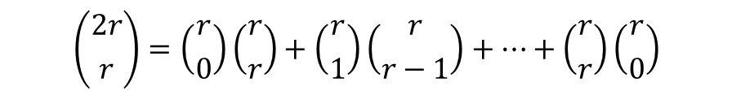
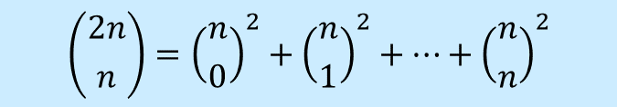


Q2.
$$\left({m+n \atop r}\right)=\left({m \atop 0}\right)\left({n \atop r}\right)+\left({m \atop 1}\right)\left({n \atop r−1}\right)+⋯+\left({m \atop r}\right)\left({n \atop 0}\right)$$
… (A)
where $m,n∈ℤ^{+},r≤m$ and $r≤n$.
Using equation (A), prove that for all integers $n≥0,$
$$\left({2n \atop n}\right)={\left({n \atop 0}\right)}^{2}+{\left({n \atop 1}\right)}^{2}+⋯+{\left({n \atop n}\right)}^{2}$$
Let $m=n=r$, then equation (A) becomes
$$\left({2r \atop r}\right)=\left({r \atop 0}\right)\left({r \atop r}\right)+\left({r \atop 1}\right)\left({r \atop r−1}\right)+⋯+\left({r \atop r}\right)\left({r \atop 0}\right)$$
From Lecture #12 example 8, $\left({n \atop r}\right)=\left({n \atop n−r}\right)$, therefore the above is equivalent to
$$\left({2r \atop r}\right)=\left({r \atop 0}\right)\left({r \atop 0}\right)+\left({r \atop 1}\right)\left({r \atop 1}\right)+⋯+\left({r \atop r}\right)\left({r \atop r}\right)={\left({r \atop 0}\right)}^{2}+{\left({r \atop 1}\right)}^{2}+⋯+{\left({r \atop r}\right)}^{2}$$

Slide 7
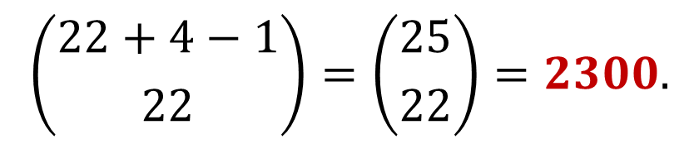
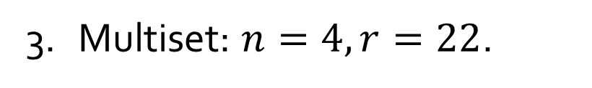
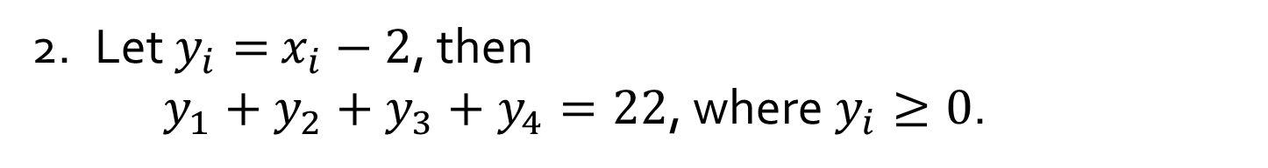
Q3.
How many solutions are there to the following equation?
$x_{1}+x_{2}+x_{3}+x_{4}=30$, where $x_{i}$ are integers and $x_{i}≥2$ .
1. ${(x}_{1}−2)+{(x}_{2}−2)+{(x}_{3}−2)+{(x}_{4}−2)=30−8=22$.
2. Let $y_{i}=$ $x_{i}−2$, then
$y_{1}+y_{2}+y_{3}+y_{4}=22$, where $y_{i}≥0$.
3. Multiset: $n=4, r=22$.
4.
$$\left({22+4−1 \atop 22}\right)=\left({25 \atop 22}\right)=2300.$$

Slide 8
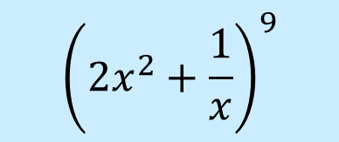

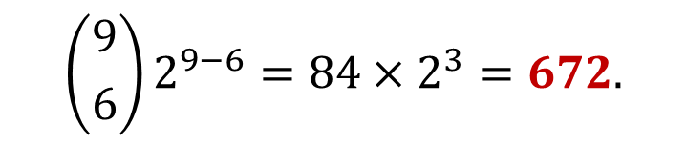
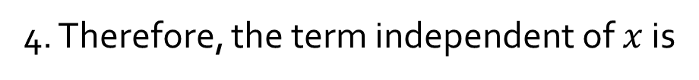
Q4.
Find the term independent of $x$ in the expansion of
$${\left(2x^{2}+\frac{1}{x}\right)}^{9}$$
Recall the Binomial Theorem:
$${\left(a+b\right)}^{n}=a^{n}+\left({n \atop 1}\right)a^{n−1}b^{1}+\left({n \atop 2}\right)a^{n−2}b^{2}+⋯+\left({n \atop n−1}\right)a^{1}b^{n−1}+b^{n}$$
1. We have $a=2x^{2},b=\frac{1}{x},n=9.$
2. The general term in the expansion of ${(a+b)}^{2}$ is given by:
$$\left({n \atop r}\right)a^{n−r}b^{r}=\left({9 \atop r}\right){(2x^{2})}^{9−r}{\left(\frac{1}{x}\right)}^{r}=\left({9 \atop r}\right)2^{9−r}x^{18−2r}x^{−r}=\left({9 \atop r}\right)2^{9−r}x^{18−3r}$$
3. For this term to be independent of $x$, we must have $18−3r=0,$ or $r=6$.
4. Therefore, the term independent of $x$ is
$$\left({9 \atop 6}\right)2^{9−6}=84×2^{3}=672.$$

Slide 9


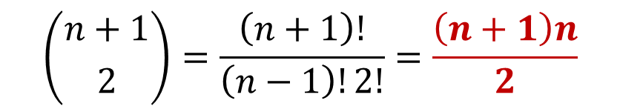
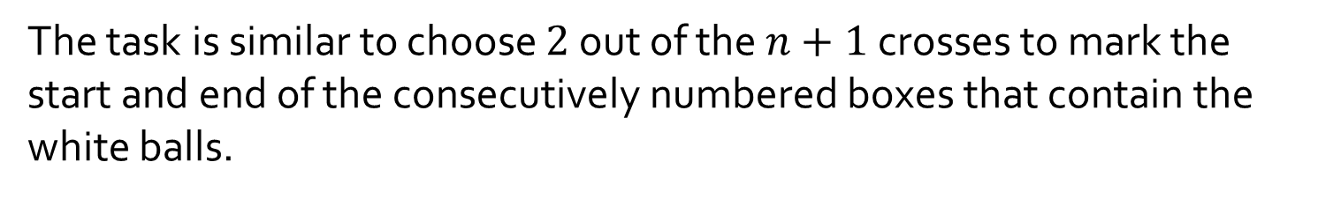
Q5.
Given n boxes numbered 1 to n, each box to be filled with a white ball or a blue ball. At least one box contains a white ball and boxes containing white balls must be consecutively numbered.
What is the total number of ways this can be done?
$$\sum_{k=1}^{n}{k}=\frac{n\left(n+1\right)}{2}$$
X
X
X
X
…
X
X
1 2 3 … n
The task is similar to choose $2$ out of the $n+1$ crosses to mark the start and end of the consecutively numbered boxes that contain the white balls.
$$\left({n+1 \atop 2}\right)=\frac{\left(n+1\right)!}{\left(n−1\right)!2!}=\frac{\left(n+1\right)n}{2}$$

Slide 10

Q6.
A lottery game offers $1 million to the grand prize winner, $1000 to each of the 100 second prize winners, $500 to each of the 300 third prize winners and $10 to each of the 1,000 consolation prize winners. The cost of the lottery is $3 per ticket and 500,000 tickets were sold. What is the expected gain or loss of a ticket?
Net gain of grand prize winner =
$999,997.
Net gain of each of the 100 2nd prize winners =
$997.
Net gain of each of the 300 3rd prize winners =
$497.
Net gain of each of the 1,000 consolation prize winners =
$7.
Net gain of each of the remaining 498,599 people =
-$3.
Expected gain/loss
$$=\frac{1}{500000}(\$999997×1+\$997×100+\$497×300+\$7×1000+(−\$3)×498599)$$
$$=−\$0.48.$$

Slide 11
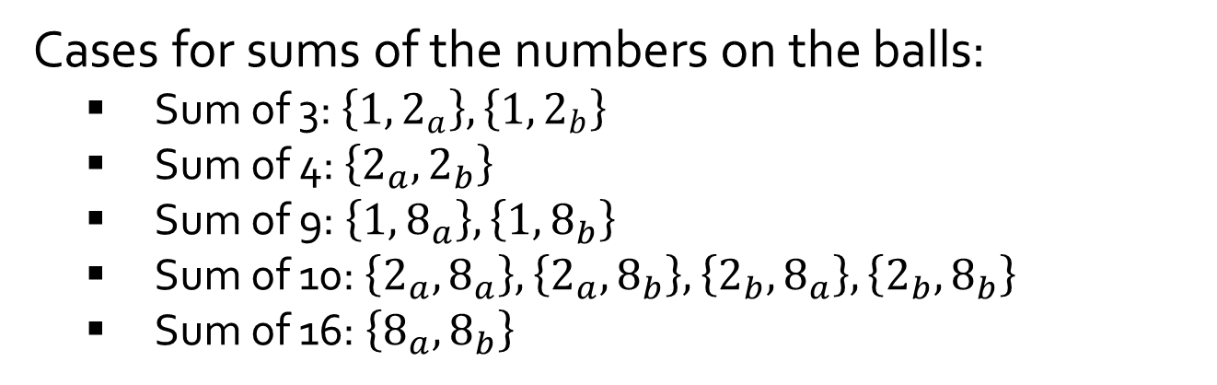
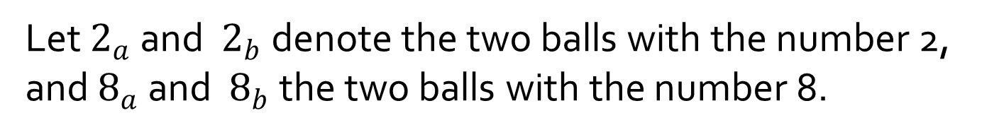

Q7.
An urn contains five balls numbered 1, 2, 2, 8 and 8. If a person selects a set of two balls at random, what is the expected value of the sum of the numbers on the balls?
Let $2_{a}$ and $2_{b}$ denote the two balls with the number 2, and $8_{a}$ and $8_{b}$ the two balls with the number 8.
Cases for sums of the numbers on the balls:
Sum of 3: $\left\{1,2_{a}\right\}, \left\{1,2_{b}\right\}$
Sum of 4: $\left\{2_{a},2_{b}\right\}$
Sum of 9: $\left\{1,8_{a}\right\}, \left\{1,8_{b}\right\}$
Sum of 10: $\left\{2_{a},8_{a}\right\}, \left\{2_{a},8_{b}\right\},\left\{2_{b},8_{a}\right\}, \left\{2_{b},8_{b}\right\}$
Sum of 16: $\left\{8_{a},8_{b}\right\}$
Expected sum
$=3∙\left(\frac{2}{10}\right)+$ $4∙\left(\frac{1}{10}\right)+9∙\left(\frac{2}{10}\right)+$ $10∙\left(\frac{4}{10}\right)+16∙\left(\frac{1}{10}\right)$
$$=8.4$$

Slide 12

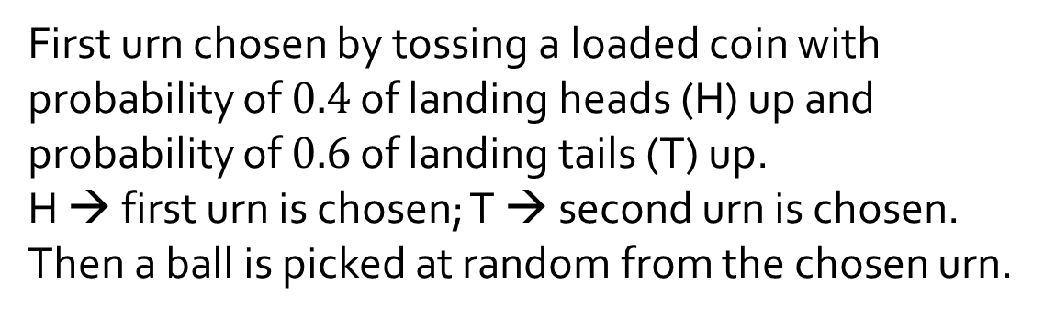

Q8.
Urn 1
Urn 2
First urn chosen by tossing a loaded coin with probability of $0.4$ of landing heads (H) up and probability of $0.6$ of landing tails (T) up.
H → first urn is chosen; T → second urn is chosen.
Then a ball is picked at random from the chosen urn.
10 red
25 green
22 red
15 green
(a) What is the probability that the chosen ball is green?
$$\left(\frac{4}{10}\right)\left(\frac{25}{35}\right)+\left(\frac{6}{10}\right)\left(\frac{15}{37}\right)=52.9\%$$

Slide 13
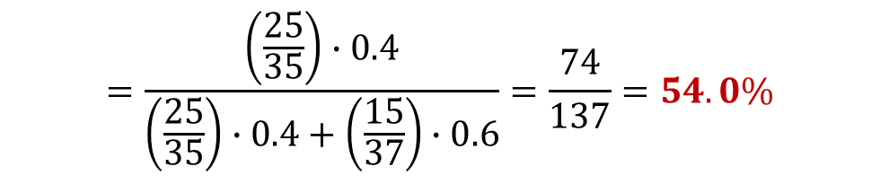
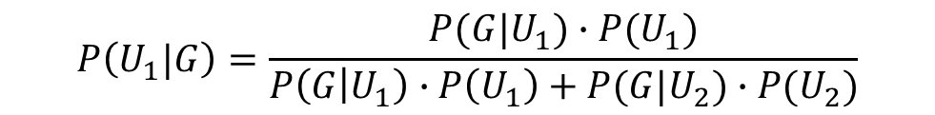
Q8.
Urn 1
Urn 2
First urn chosen by tossing a loaded coin with probability of $0.4$ of landing heads (H) up and probability of $0.6$ of landing tails (T) up.
H → first urn is chosen; T → second urn is chosen.
Then a ball is picked at random from the chosen urn.
10 red
25 green
22 red
15 green
(b) If the chosen ball is green, what is the probability that it was picked from the first urn?
Let $G$ be the event that the chosen ball is green, $U_{1}$ the event that the ball came from the first urn, and $U_{2}$ the event that the ball came from the second urn.
$$P\left(U_{1}\right)=0.4, P\left(U_{2}\right)=0.6, P\left(G | U_{1}\right)=\frac{25}{35}, P\left(G | U_{2}\right)=\frac{15}{37}.$$
By Bayes’ Theorem,
$$P\left(U_{1}|G\right)=\frac{P(G|U_{1})∙P(U_{1})}{P\left(G | U_{1}\right)∙P\left(U_{1}\right)+P(G|U_{2})∙P(U_{2})}$$
$$=\frac{\left(\frac{25}{35}\right)∙0.4}{\left(\frac{25}{35}\right)∙0.4+\left(\frac{15}{37}\right)∙0.6}=\frac{74}{137}=54.0\%$$

Slide 14
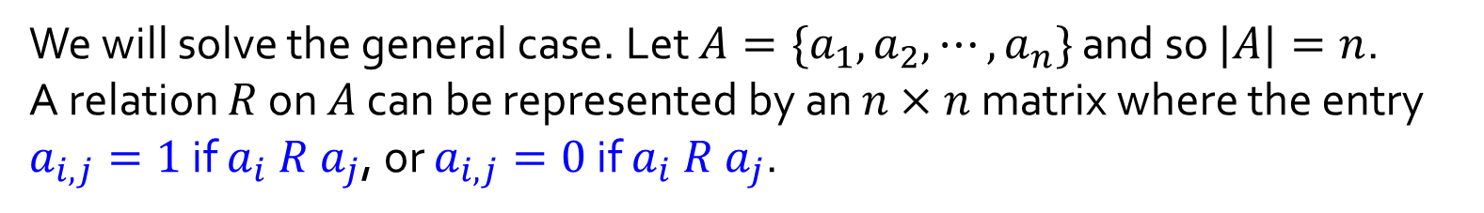
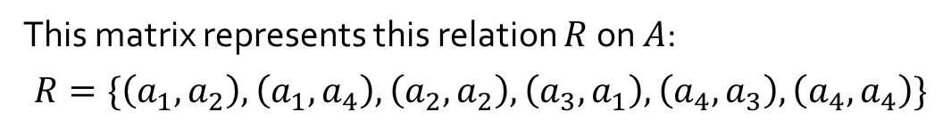
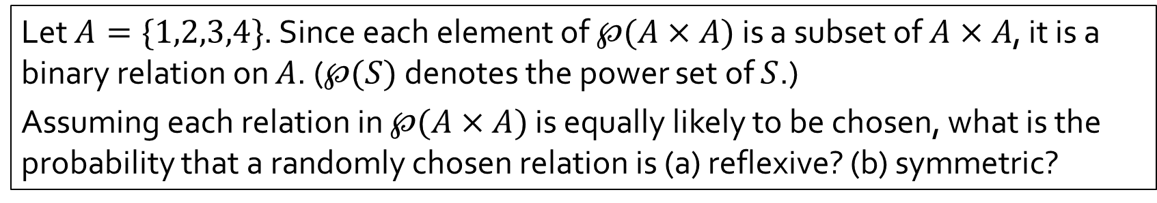


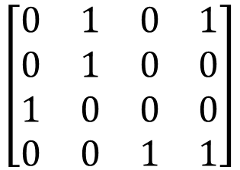
Q9.
Let $A=\{1,2,3,4\}$. Since each element of $℘(A×A)$ is a subset of $A×A$, it is a binary relation on $A$. ($℘(S)$ denotes the power set of $S$.)
Assuming each relation in $℘(A×A)$ is equally likely to be chosen, what is the probability that a randomly chosen relation is (a) reflexive? (b) symmetric?
We will solve the general case. Let $A=\{a_{1},a_{2},⋯,a_{n}\}$ and so $|A|=n$.
A relation $R$ on $A$ can be represented by an $n×n$ matrix where the entry $a_{i,j}=1$ if $a_{i} R a_{j}$, or $a_{i,j}=0$ if $a_{i} R a_{j}$.
Example:
$$a_{1}{ a}_{2} a_{3} a_{4}$$
$$a_{1}$$
$$a_{2}$$
$$a_{3}$$
$$a_{4}$$
$$\left[\begin{matrix}0 & 1 & 0 & 1 \\ 0 & 1 & 0 & 0 \\ 1 & 0 & 0 & 0 \\ 0 & 0 & 1 & 1\end{matrix}\right]$$
This matrix represents this relation $R$ on $A$:
$$R=\{\left(a_{1},a_{2}\right),\left(a_{1},a_{4}\right),\left(a_{2},a_{2}\right),\left(a_{3},a_{1}\right),\left(a_{4},a_{3}\right),\left(a_{4},a_{4}\right)\}$$

Slide 15
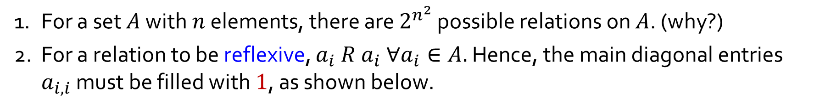
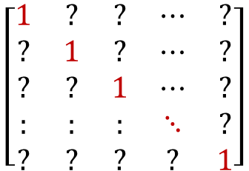
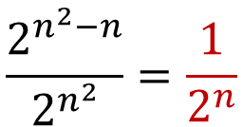
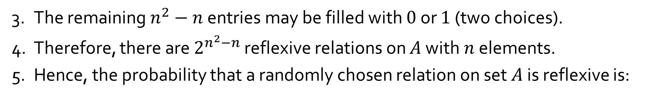
Q9.
(a) Reflexive relations
1. For a set $A$ with $n$ elements, there are $2^{n^{2}}$ possible relations on $A$. (why?)
2. For a relation to be reflexive, $a_{i} R a_{i} ∀a_{i}∈A.$ Hence, the main diagonal entries $a_{i,i}$ must be filled with $1$, as shown below.
$$\left[\begin{matrix}1 & ? & ? & ⋯ & ? \\ ? & 1 & ? & ⋯ & ? \\ ? & ? & 1 & ⋯ & ? \\ : & : & : & ⋱ & ? \\ ? & ? & ? & ? & 1\end{matrix}\right]$$
3. The remaining $n^{2}−n$ entries may be filled with $0$ or $1$ (two choices).
4. Therefore, there are $2^{n^{2}−n}$ reflexive relations on $A$ with $n$ elements.
5. Hence, the probability that a randomly chosen relation on set $A$ is reflexive is:
$$\frac{2^{n^{2}−n}}{2^{n^{2}}}=\frac{1}{2^{n}}$$
In particular, when $n=4$, the probability is $\frac{1}{2^{4}}$ or $\frac{1}{16}.$

Slide 16
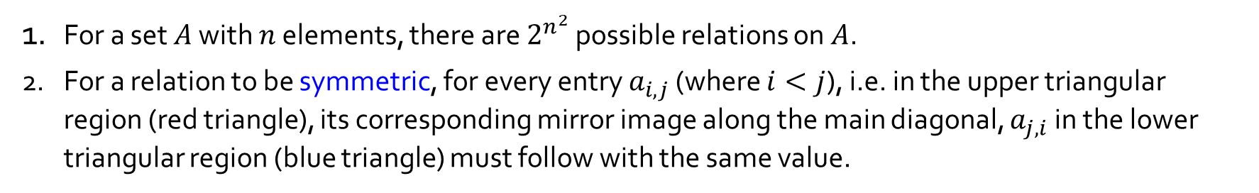


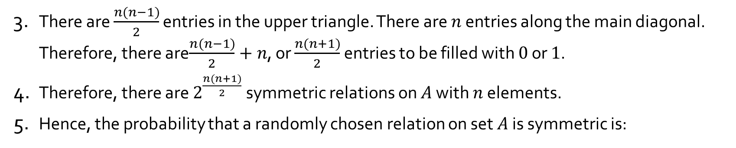
Q9.
(b) Symmetric relations
1. For a set $A$ with $n$ elements, there are $2^{n^{2}}$ possible relations on $A$.
2. For a relation to be symmetric, for every entry $a_{i,j}$ (where $i<j$), i.e. in the upper triangular region (red triangle), its corresponding mirror image along the main diagonal, $a_{j,i}$ in the lower triangular region (blue triangle) must follow with the same value.
$$\left[\begin{matrix}? & ? & ? & ⋯ & ? \\ ? & ? & ? & ⋯ & ? \\ ? & ? & ? & ⋯ & ? \\ : & : & : & ⋱ & ? \\ ? & ? & ? & ? & ?\end{matrix}\right]$$
3. There are $\frac{n(n−1)}{2}$ entries in the upper triangle. There are $n$ entries along the main diagonal. Therefore, there are$\frac{n(n−1)}{2}+n$, or $\frac{n(n+1)}{2}$ entries to be filled with $0$ or $1$.
4. Therefore, there are $2^{\frac{n(n+1)}{2}}$ symmetric relations on $A$ with $n$ elements.
5. Hence, the probability that a randomly chosen relation on set $A$ is symmetric is:
$$\frac{2^{\frac{n(n+1)}{2}}}{2^{n^{2}}}=\frac{1}{2^{\frac{n^{2}−n}{2}}}$$
In particular, when $n=4$, the probability is $\frac{1}{2^{6}}$ or $\frac{1}{64}.$

Slide 17
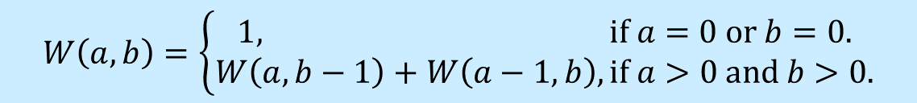
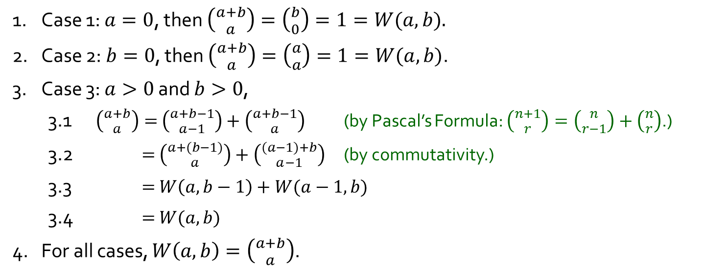
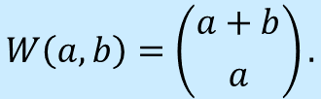
Q10.
Let us define a function $W(a,b)$ to be the number of ways the tournament can be completed if team $A$ has to win $a$ more games to win, while team $B$ has to win $b$ more games to win.
$$W\left(a,b\right)=\left\{\begin{aligned}1, if a=0 or b=0. \\ W\left(a,b−1\right)+W\left(a−1,b\right), if a>0 and b>0.\end{aligned}\right.$$
Verify that $W(a,b)$ may be expressed as follows:
$$W\left(a,b\right)=\left({a+b \atop a}\right).$$
1. Case 1: $a=0$, then $\left({a+b \atop a}\right)=\left({b \atop 0}\right)=1=W(a,b).$
2. Case 2: $b=0$, then $\left({a+b \atop a}\right)=\left({a \atop a}\right)=1=W(a,b)$.
3. Case 3: $a>0$ and $b>0$,
3.1 $\left({a+b \atop a}\right)=$ $\left({a+b−1 \atop a−1}\right)+\left({a+b−1 \atop a}\right)$ (by Pascal’s Formula: $\left({n+1 \atop r}\right)=\left({n \atop r−1}\right)+\left({n \atop r}\right)$.)
3.2 $=$ $\left({a+(b−1) \atop a}\right)+\left({(a−1)+b \atop a−1}\right)$ (by commutativity.)
3.3 $=$ $W\left(a,b−1\right)+W(a−1,b)$
3.4 $=$ $W(a,b)$
4. For all cases, $W\left(a,b\right)=\left({a+b \atop a}\right)$.

Slide 18
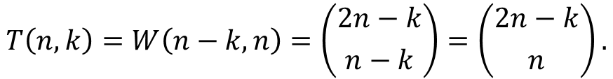
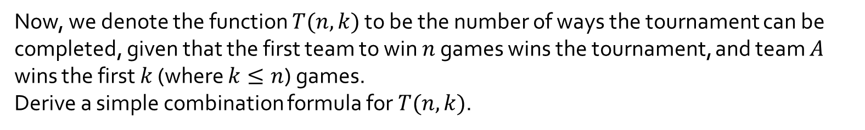



Q10.
$$W\left(a,b\right)=\left({a+b \atop a}\right).$$
Now, we denote the function $T(n,k)$ to be the number of ways the tournament can be completed, given that the first team to win $n$ games wins the tournament, and team $A$ wins the first $k$ (where $k≤n$) games.
Derive a simple combination formula for $T(n,k)$.
$$T\left(n,k\right)=W\left(n−k,n\right)=\left({2n−k \atop n−k}\right)=\left({2n−k \atop n}\right).$$
(by lecture 12 example 8: $\left({n \atop r}\right)=\left({n \atop n−r}\right)$.)
Therefore, $T\left(4,2\right)=\left({6 \atop 4}\right)=15.$

Slide 19
THE END

